Slide 1

ADSAI: Data Science 1: The World in Data
Bram Heijligers & Nitin Bhushan

Slide 2

Introduction Lecturers
Bram Heijligers
PhD-candidate [title], 2020 - Ungoing; Tilburg University
MSc Cognitive Science and Artificial Intelligence, 2018 - 2020; Tilburg University
BSA International Game Architecture and Design – Design and Production, 2012 - 2018; Breda University of Applied Sciences
Neuro-cognitive research into learning and game experience
Game Design and Project management
(Mixed-Reality) Educational Games
Managing Covid-19 Contract Tracing Operations

Slide 3
Introduction Lecturers
Nitin Bhushan
Qualifications?
Portfolio and work experience

Slide 4
What is data science?
Bram:
“Somebody who solves problems using data analyses in a computerized environment.”
Wikipedia:
“Data science is an interdisciplinary field that uses scientific methods, processes, algorithms and systems to extract knowledge and insights from noisy, structured and unstructured data,[1][2] and apply knowledge and actionable insights from data across a broad range of application domains.”
IBM:
“Data science combines the scientific method, math and statistics, specialized programming, advanced analytics, AI, and even storytelling to uncover and explain the business insights buried in data.”

Slide 5
What is data science?
Bram:
“Somebody who solves problems using data analyses in a computerized environment.”
Wikipedia:
“Data science is an interdisciplinary field that uses scientific methods, processes, algorithms and systems to extract knowledge and insights from noisy, structured and unstructured data,[1][2] and apply knowledge and actionable insights from data across a broad range of application domains.”
IBM:
“Data science combines the scientific method, math and statistics, specialized programming, advanced analytics, AI, and even storytelling to uncover and explain the business insights buried in data.”

Slide 6

What is data science?

Slide 7
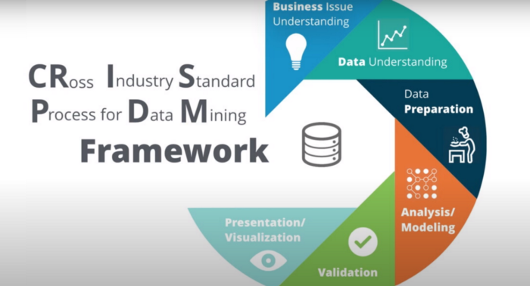
CRISP-DM

Slide 8
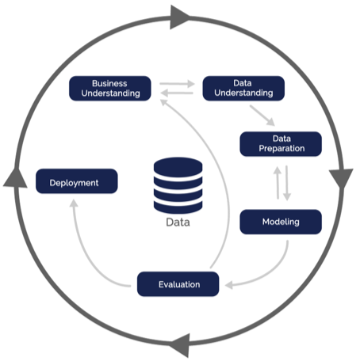
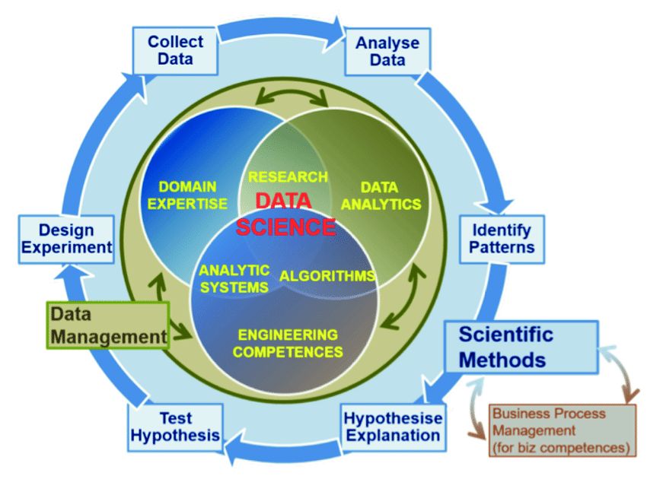
CRISP-DM
There are many varieties...
We base our curriculum on the EDSION
Data Science Competency Framework
as proposed by the European Union.
Don’t worry too much about it in the first
year though: we’ll guide you through it!

Slide 9
What is data?
Bram:
“Real-world properties translated into some abstract form; numbers or text, so people can understand relationships between objects and/or phenomena”
Wikipedia:
“Data are individual facts, statistics, or items of information, often numeric, that are collected through observation.[1] In a more technical sense, data are a set of values of qualitative or quantitative variables about one or more persons or objects,[1] while a datum (singular of data) is a single value of a single variable.[2].”
Cambridge Dictionary:
“information, especially facts or numbers, collected to be examined and considered and used to help decision-making, or information in an electronic form that can be stored and used by a computer:”

Slide 10
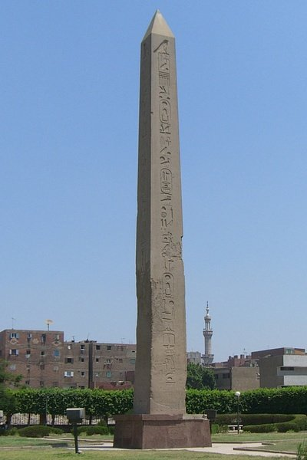
How do we describe an object?
Words are commonly used to describe an object and it’s relationship an place in the world.
Large
Long
Old
Heavy
[Student examples]
These words we assign to an object can be further defined in a more precise way.
Specifically we can use numbers or categories to give them a more meaningful description.
We call these ‘descriptions’ variables and they’ve been around since the dawn of language:
Pre-historic: Dog-Dog-Dog
Now: Three dogs

Slide 11
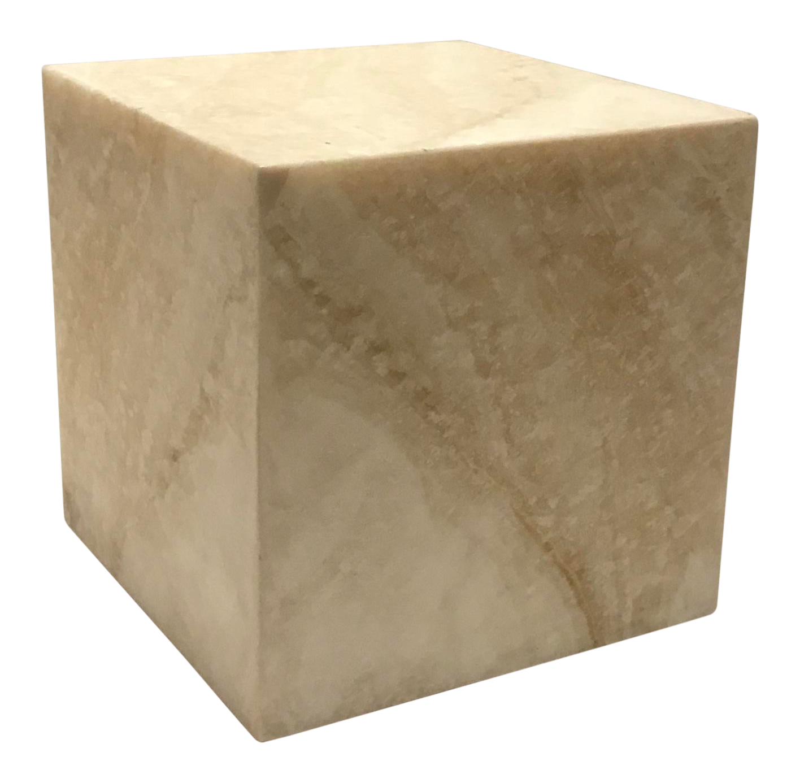
Objects quantified to data
Variables:
Shape = Cube
Size = 1 x 1 x 1 Meters = 1 m ³
Material = Marble
Material Density = 0.5 g/cm ³
Weight = Size X Material Density
Weight = 0.5 g/cm ³ X 1.000.000
Weight = 500.000 grams = 500 KG
Notes:
Mass
Weight
Height
Age
Orientation
Position

Slide 12
Why would do we do this?
To solve problems.
Yes, thank you... But how does this help us?
Mathematics is essential an abstract way to define relationships between real-world entities.
Translating real-world properties into data enables us to leverage that toolbox: it gives us a framework with which we can understand objects and phenomena in the world and how they affect one another.
.

Slide 13
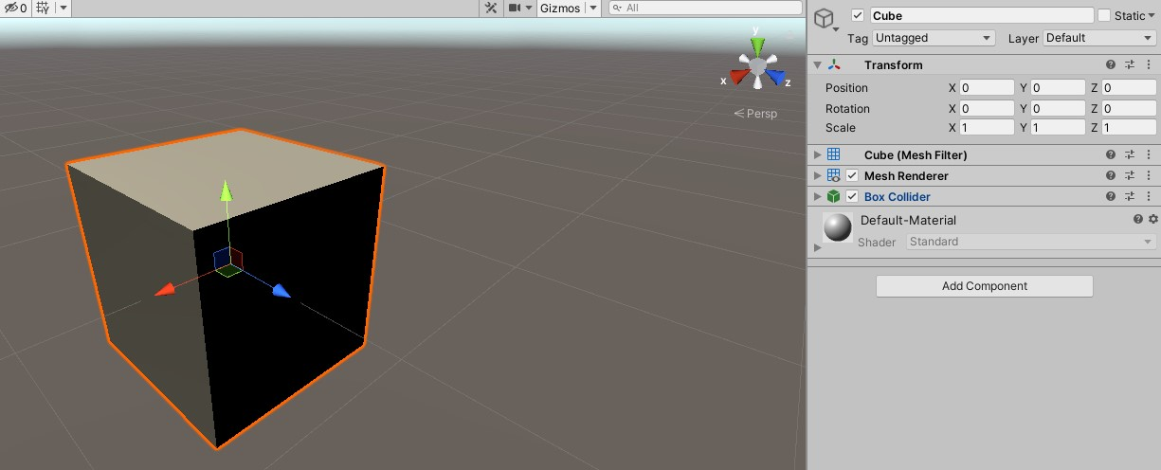
Objects quantified to data
Variables:
[var1]
Notes:
Mass
Weight
Height
Age
Orientation
Position

Slide 14
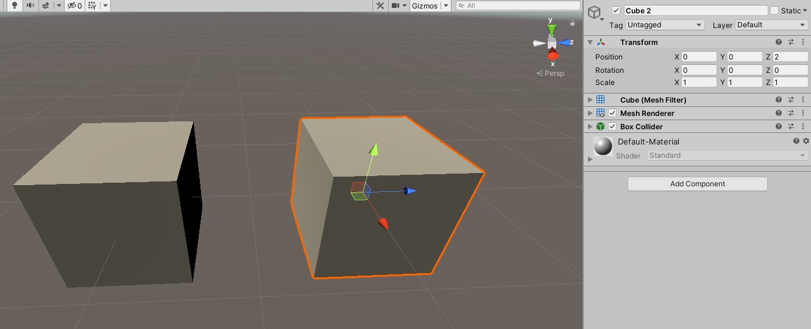
Objects quantified to data
Variables:
[var1]
Notes:
Mass
Weight
Height
Age
Orientation
Position

Slide 15
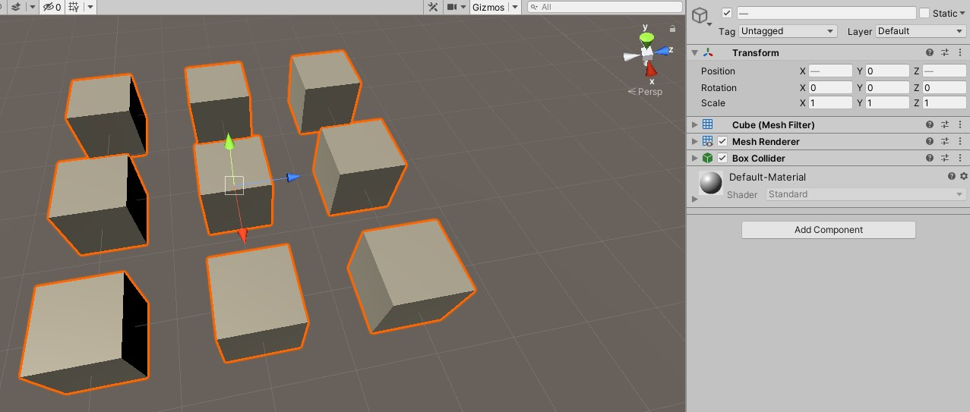
Objects quantified to data
Variables:
[var1]
Notes:
Mass
Weight
Height
Age
Orientation
Position

Slide 16

You in data; QS
Age
Height
Weight
Location (X,Y,Z) at Time A
[Student examples]

Slide 17
You in data; QS
[keep track of some data as a student; coffee drank a day]
How tired are you at the end of the day
How difficult was today’s Datalab?

Slide 18
Bram in data; QS
You can also capture social and behavioural phenomena which emerge by the interaction of individuals with one another and environment:

Slide 19

How do we describe phenomena?
Humidity
Luminosity
Cloud height
Electrical Load
Voltage
Ampere
Ohm
Watt
Dynamic properties

Slide 20
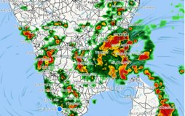
Phenomena quantified
Weather things
Covid-19 spread
Social network analysis

Slide 21
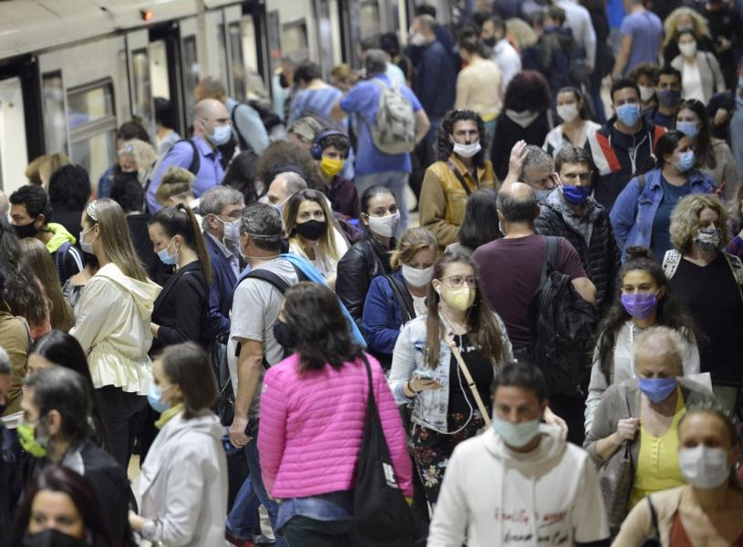
How do we describe phenomena?
text

Slide 22
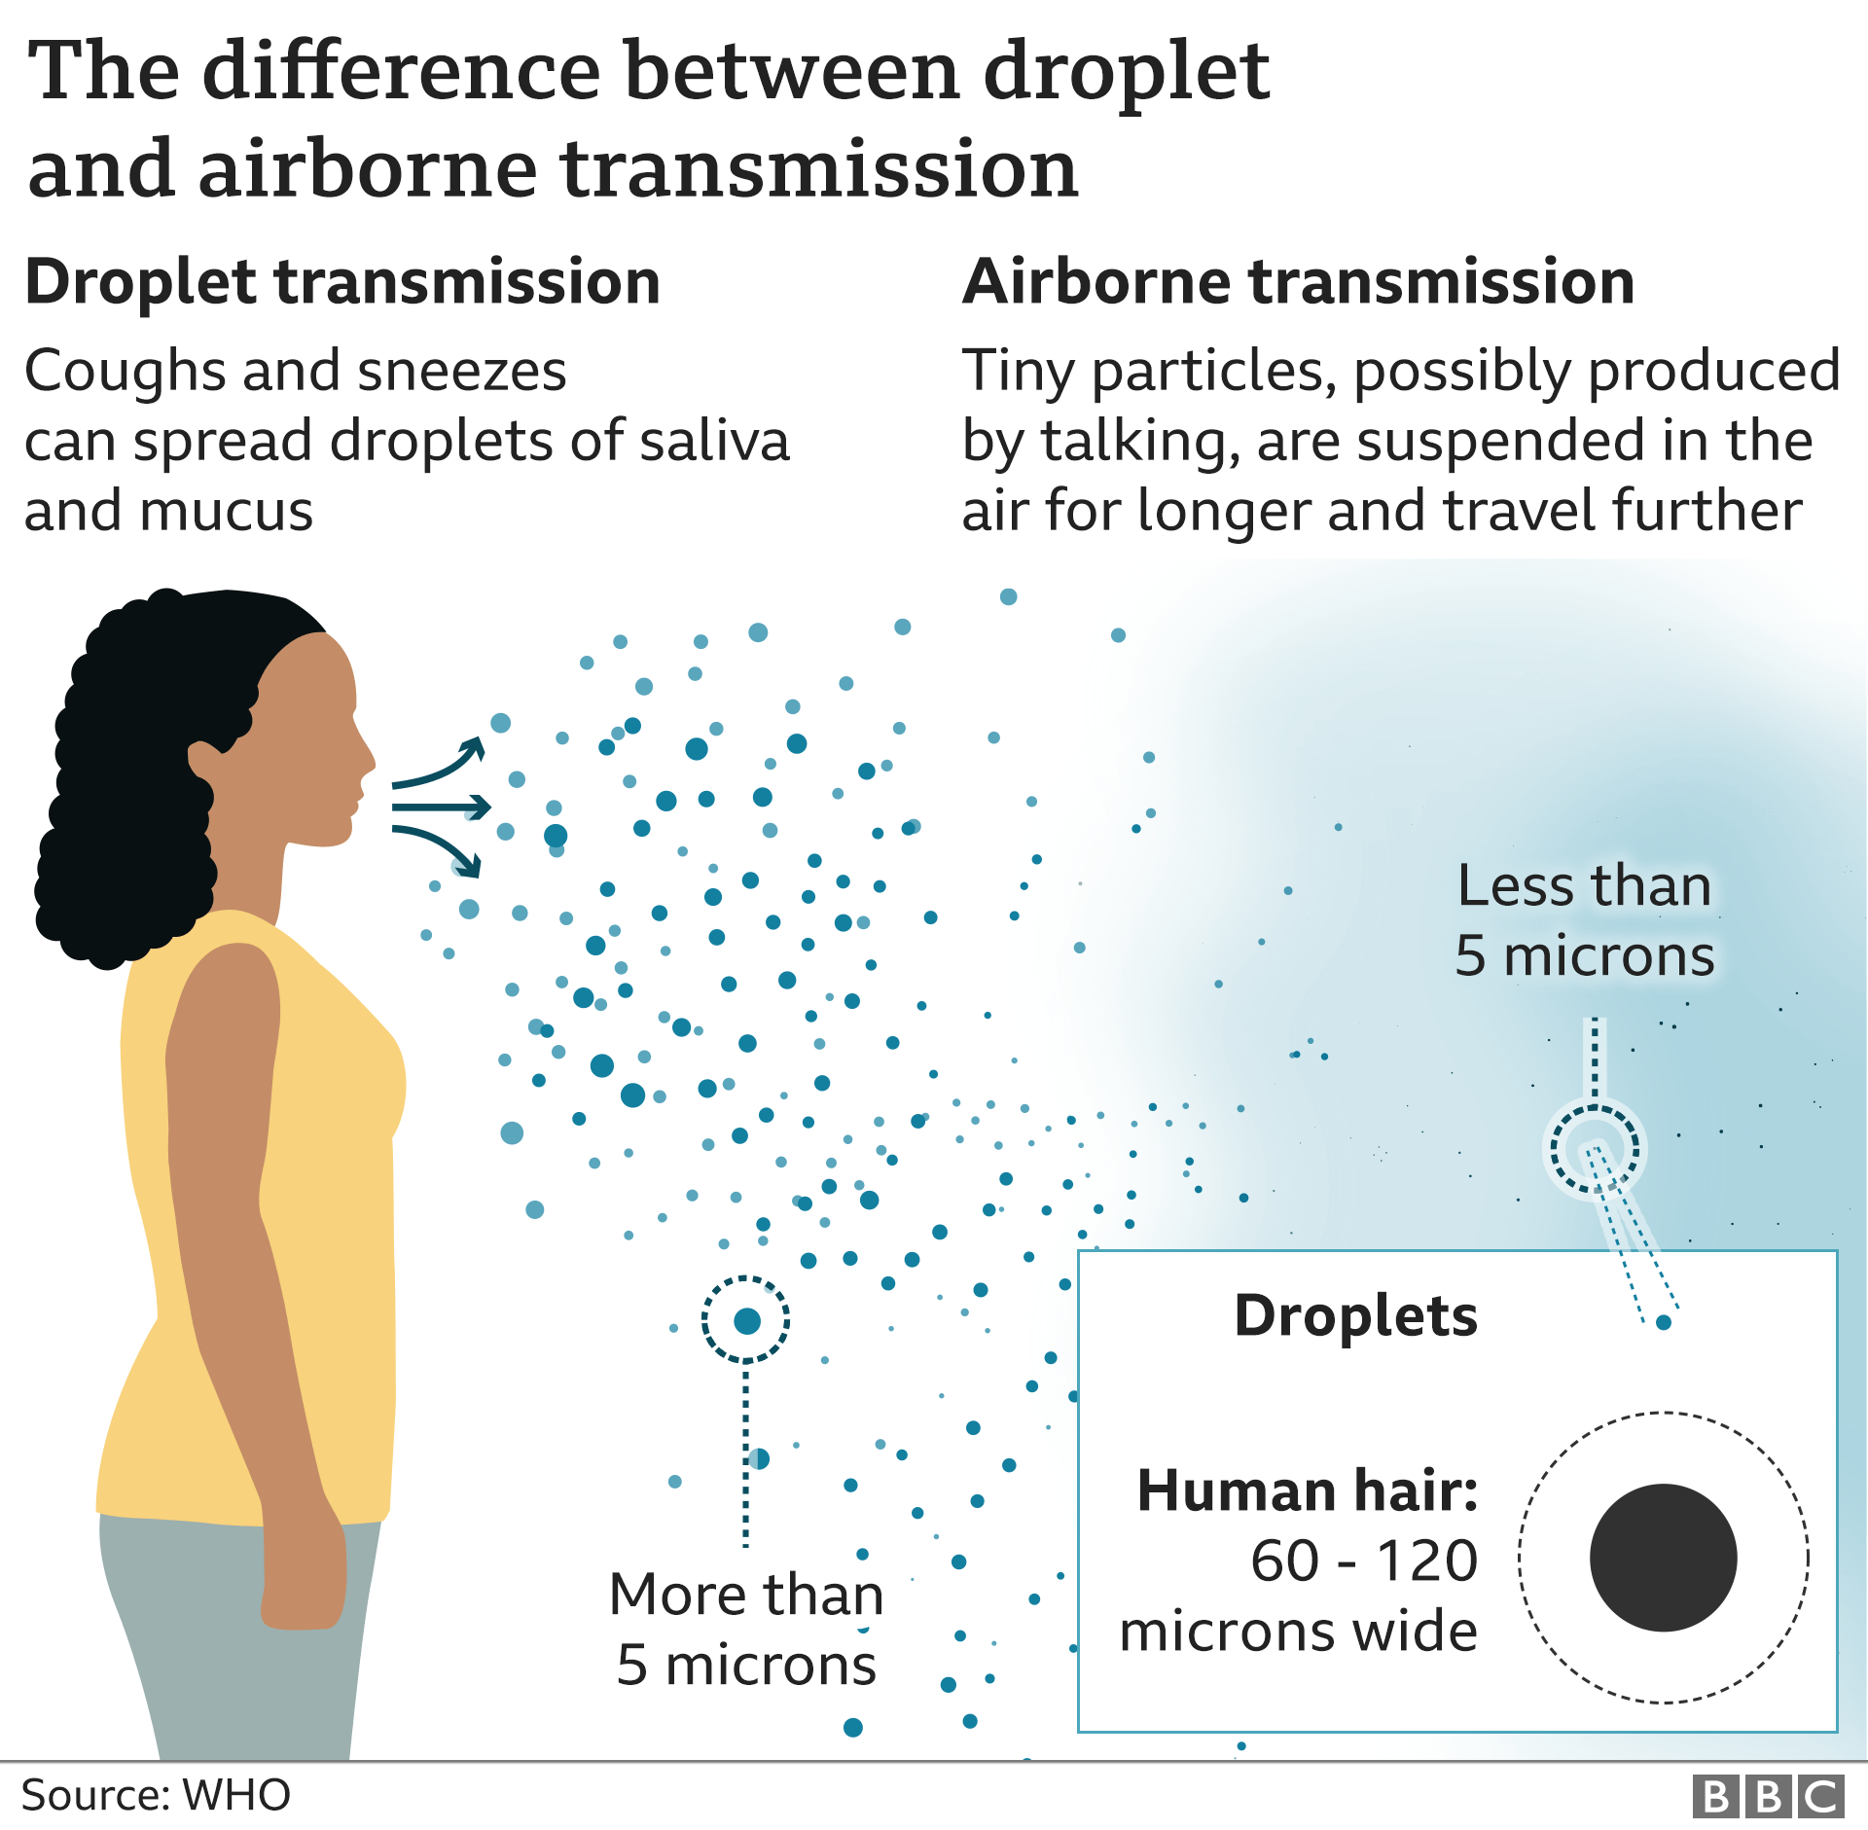
Phenomena quantified
Weather things
Covid-19 spread
Social network analysis

Slide 23
Phenomena quantified
https://gisanddata.maps.arcgis.com/apps/opsdashboard/index.html#/bda7594740fd40299423467b48e9ecf6
https://www.cdc.gov/coronavirus/2019-ncov/covid-data/forecasting-us.html

Slide 24
How do we store and process data?
We’ll get into that next lecture, it’s better to consume and apply knowledge in small chunks.
Now let’s look at the course approach and structure!
Then we’ll have some hands-on work: some programming where we hold your hand (figuratively; COVID-Regulations)

Slide 25
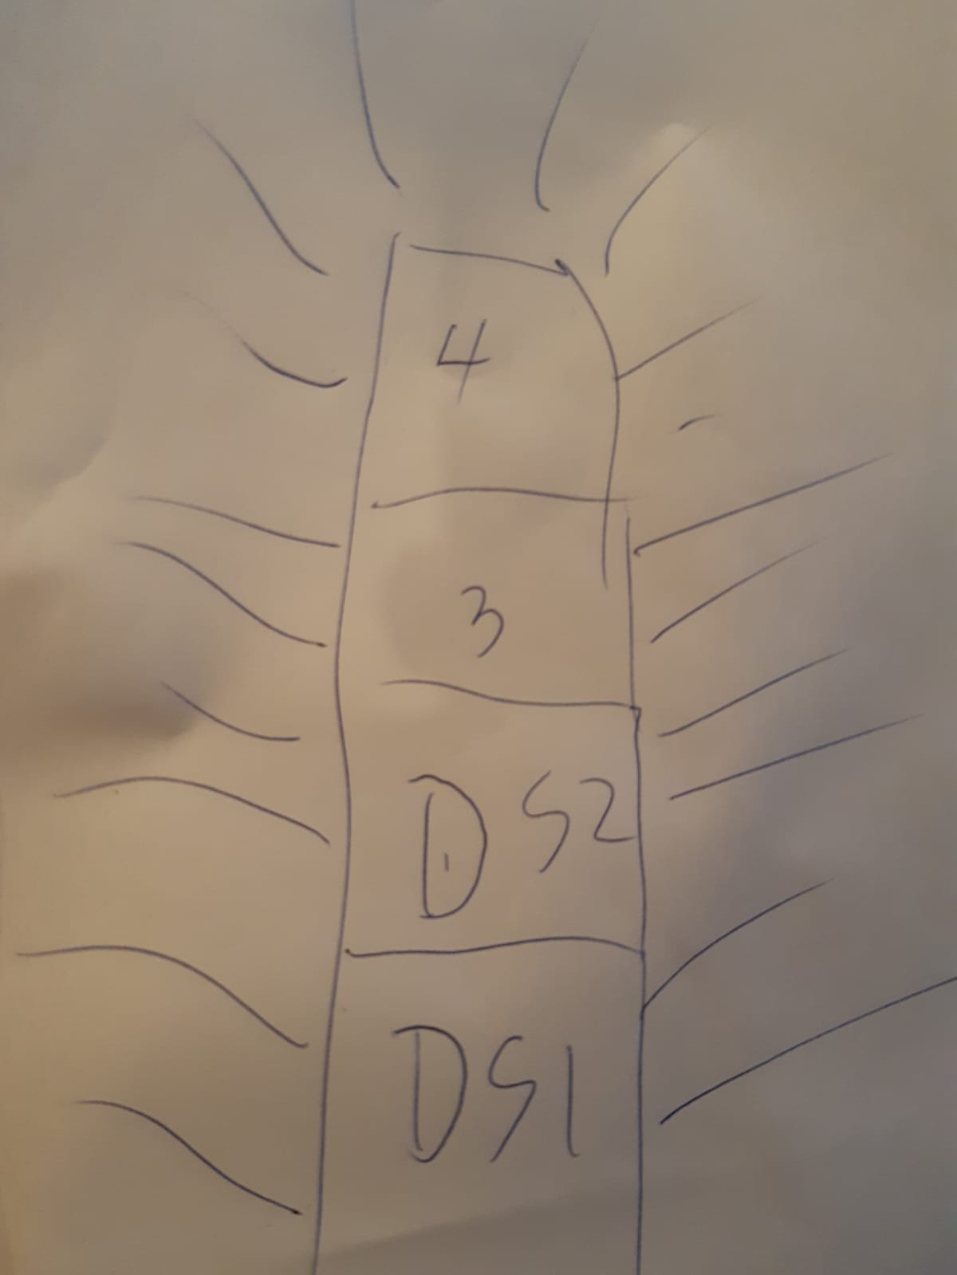
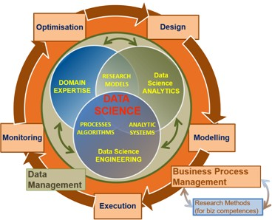
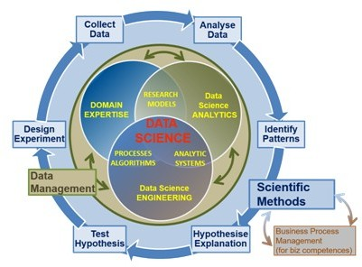
Educational Approach
Things
Notes:
Maybe too complex for block a, year 1

Slide 26
Course Approach
3 days a week where every course day is structured as follow:
Video-lecture for presenting and discussing the main concepts, using practical examples: 30 – 1 hours
Structured self-study at home or in Data Lab: 3 - 6
Working on assessment building-blocks at home or in Data Lab: 1 – 4 Hours

Slide 27
Course Content
Introduction to Data Science(codifying the world in data, attributes)
Variables (data frames, continuous, nominal, ordinal etc.)
Descriptive analyses (mean, sd, range, IQR) & visualisation (boxplots)
Introduction to Probability (random variable, distributions)
Introduction to statistical inference (sample, population, hypothesis testing)
Analysing Relationships between variables (e.g., compute correlation by hand)
Reporting & visualising (Academic Skills)
Introduction to regression & machine learning(supervised, unsupervised, the CRISP DM model)
Conference Poster Creation
You are here

Slide 28
Assessment
Create a Conference Poster based on case studies and examples introduced online and in-class; the focus is on all stages of the data science process:
formulating the problem;
selecting the data;
exploratory data analyses technique(s);
interpretation of descriptive data;
reporting and visualizing the data;
propose next steps: an analysis to run on the data.
Building blocks for the final poster are created at the end of each workshop day, they can be handed till the end of the day for feedback before assessment. So, it you attend; and work during, all the Datalabs, you should be golden ☺
Notes:
So there's only one assement: the datalab one.

Slide 29
Practical details
Self Study days: Feel free to plan as you like. However, you’ll have the highest likelihood of efficient learning if you do study on the allocated days, specifically: Monday, Wednesday & Thursday: 9:00 – 16:00
Daily Questions and Answers hour:
Monday, Wednesday & Thursday: 16:00 – 17:00
Datalab days (Mandatory):
- Tuesdays & Fridays from 9:00 to 17:00.

Slide 30
Any questions?
Ask me on Microsoft Teams, I reply during working hours. (9:00 – 17:00, Monday to Friday)
You can also e-mail me at: Heijligers.b@buas.nl

